Slide 1
Master of Software Engineering
- Modern Financial Practices
软件工程硕士–现代金融业务
College of Software Technology (Ningbo), Zhejiang University
浙江大学软件学院（宁波）
Class 1 Stock

Slide 2
Outlines
Class 1: Stock
Class 2: Fixed Income
Class 3: Foreign Exchange
Class 4: Fund

Slide 3
Content
1. International Financial Markets
  International Markets overview
2. International Stock Markets
  Stock Basis
  Stock Markets Trading Flow
3. Stock Trade Operation
  Stock Basis
  Stock Markets Trading Flow
4. Stock Analysis
  Fundamental Analysis
  Technical analysis

Slide 4
Reference
Financial Markets and Institutions (Third Edition), Frederic S. Mishkin, Stanley G. Eakins， 清华大学出版社
金融市场与金融机构 （第五版），杰夫.马杜拉， 中信出版社
http://en.wikipedia.org/
http://www.alpari-idc.com/
http://www.investopedia.com/
http://tools.morningstar.com/

Slide 5
Session 1
International Financial Markets

Slide 6
Financial Markets Fundamental function
“the transfer of funds from individuals or institutions with surplus funds (savers-lenders) to those who require funds (borrowers-spenders). ”
“It channels funds from parties that do not have productive use for them to those that do."

Slide 7
Financial Markets Direct Finance and Indirect Finance
Flow of funds from saver-lenders to borrower-spenders
Indirect Finance 间接金融
Financial Intermediaries
金融中介
$
$
$
Saver
Lenders
贷款人
Borrower
Spenders
借款人
$
Financial Markets
金融市场
$
Households
Businesses
Government
Foreigners
Businesses
Government
Households
Foreigners
Direct Finance 直接金融
Source: Wall Street – The Economist

Slide 8
Financial Markets Types of financial markets with Instruments
Capital markets, as long term market, which consist of:
  Stock markets, which provide financing through the issuance of shares or common stock, and enable the subsequent trading thereof.
  Bond markets, which provide financing through the issuance of bonds, and enable the subsequent trading thereof.
Money markets, which provide short term debt financing and investment.
Commodity markets, which facilitate the trading of commodities.
Derivatives markets, which provide instruments for the management of financial risk, including Forward, Future and Option markets.
Insurance markets, which facilitate the redistribution of various risks.
Foreign exchange markets, which facilitate the trading of foreign exchange.

Slide 9
Financial Markets Participants
Investor vs. Speculator
  An investor is any party that makes an investment.
  A Speculator, involves in the buying, holding, selling and short selling of stocks, bonds, commodities, currencies, real estate, derivatives, or any valuable financial instrument to profit from fluctuations in its price as opposed to buying it for use or for income via methods such as dividends or interest.
  Institutional vs. Retail.
  An institutional investor is an investor, such as a bank, insurance company, retirement fund, hedge fund, or mutual fund, that is financially sophisticated and makes large investments, often held in very large portfolios of investments. Because of their sophistication, institutional investors may often participate in private placements of securities, in which certain aspects of the securities laws may be inapplicable.
  A retail investor is an individual investor possessing shares of a given security. Retail investors can be further divided into two categories of share ownership.

Slide 10
Financial Markets categories
International vs. Domestic Financial Markets
Tangible vs. Invisible Financial Markets
Long Term vs. Short Term Financial Markets
Primary vs. Secondary Financial Markets
Financial Spot vs. Futures Markets
Capital, Money, Foreign exchange and Gold Markets

Slide 11
Financial Markets Functions
Transfer of Resources
Enhancing income
Productive usage
Capital Formation
Price determination
Sale Mechanism
Information

Slide 12
Session 2
International Stock Markets

Slide 13
Stock Market Definition
A share in the ownership of a company. Stock represents a claim on the company's assets and earnings.
Profits are sometimes paid out in the form of dividends.
Without dividends an investor can make money on a stock only through its appreciation in the open market.
Notes:
股票英文叫stock,其实stock英文最原始的意思就是白条

Slide 14
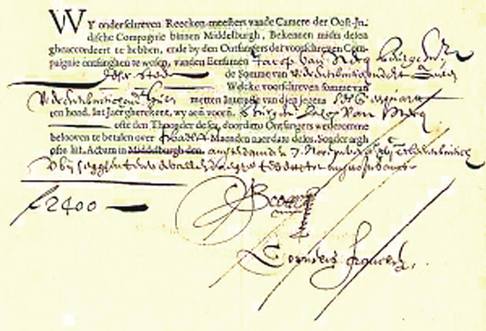
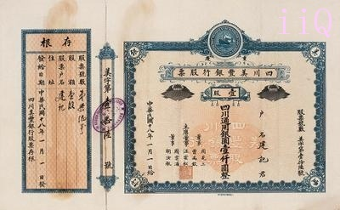
Stock Market Example stock certificate

Slide 15
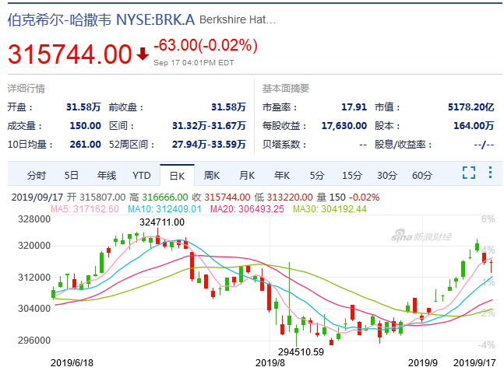
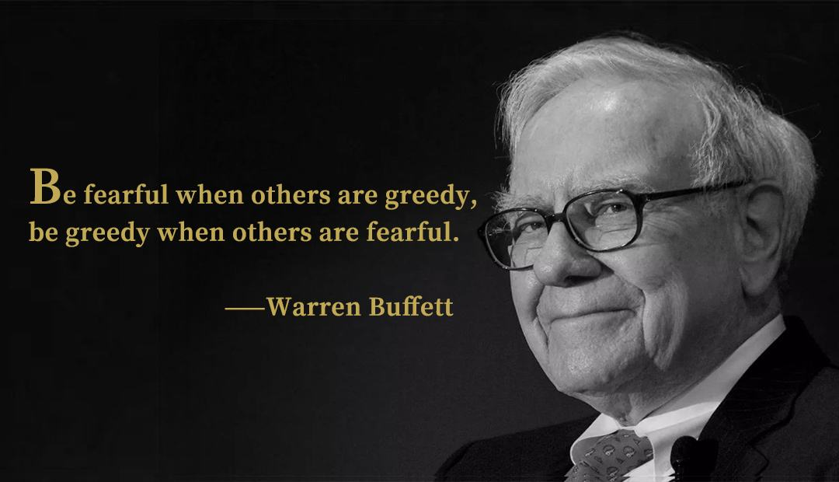
Stock Market Most Expensive Stock
Notes:
伯克希尔·哈撒韦公司是一家濒临破产的纺织厂，1956年被巴菲特收购，每股最低为7美元。

Slide 16
Stock Market Stock Type
Preferred Stock
  Described as equity ownership of a corporation’s shares where the owners are entitled to regular fixed dividend before a dividend can be paid to common stock holders.
Common Stock
  Security representing (partial) ownership of a company’s assets, generally with the right to participate in dividends and in most cases to vote on major matters affecting stockholder interests.
Convertible bond

Slide 17
Stock Market Stock Type
Class A Stock
  It is the stock issued for public trading from an IPO or if a company issues new stock at a later date.
Class B Stock
  It is a special category of stock usually retained by company founders at the time a company goes public. It carries certain rights not granted to stock available to the public. One of those rights is one share of Class B stock has 10 votes while regular shares have only one vote.
Notes:
百度总股本约3491万股普通股（1普通股=10份ADS，下文统一我们均用普通股来叙述），百度为防止恶意收购和保持创始人对公司的控制，采用了牛卡计划，将股票分为A类和B类，其中B类股的投票权是A类股的10倍，百度的A类股大约有2711万股，B类股大约780万股，但是由于B类股投票权是A类股的10倍，故B类股虽然总数没有A类股多，但是投票权综合数是A类股的3倍。
根据百度2011年年报披露，李彦宏共持有百度558万份普通股，持股比例为15.98%，其中A类股9万股，B类股549万股，李彦宏的投票权为52.22%.

Slide 18
Stock Market Major Players
Institutional Investors
  Organization whose function is to invest assets on behalf of others
  Central Banks, Pension Funds (e.g.: Calpers, NCSSF), Mutual Funds, …
Fund Managers
  Any individual firm which has responsibility for managing a fund or investment portfolio
  Schroders, Jardine Fleming, SSgA, China Asset Management
Brokers/Dealers
  Any individual or firm acting as an agent for buyers & sellers & charging a commission
  -Goldman Sachs, Morgan Stanley, Leman Brothers (bankrupt)
Global Custodians
  The keeper of international securities & other assets on behalf of investor
  -State Street, Bank of New York, JP Morgan Chase
Sub-Custodians
  Local equivalent of global custodians
  Standard Chartered Bank, HSBC, Citibank, Bank of China，。。。

Slide 19
Stock Market Stock Exchange
North America
  The New York Stock Exchange (NYSE)
  National Association of Securities Dealers Automated Quotations(NASDAQ)
Europe
  The London Stock Exchange (LSE)
  Frankfurter Wertpapierbörse (FWB)
Asia
  Tokyo Stock Exchange (TSE)
  Hong Kong Exchanges and Clearing Limite (HKEx)
  Shanghai Stock Exchange (SSE)
Notes:
国家证券业者自动报价系统协会

Slide 20
Stock Market Stock Markets Type
Primary Market (IPO)
  The primary market is that part of the stock markets that deals with the issuance of new stocks.
  Initial Public Offering (IPO), referred to simply as a "public offering," is the first sale of stock by a private company to the public. IPOs are often issued by smaller, younger companies seeking capital to expand, but can also be done by large privately-owned companies looking to become publicly traded.
Secondary Market
  The secondary market is the financial market for trading of securities that have already been issued in an initial private or public offering. Once a newly issued stock is listed on a stock exchange, investors and speculators can easily trade on the exchange, as market makers provide bids and offers in the new stock.
OTC Market
  An over-the-counter market is a financial market where products are traded over-the-counter. It is contrasted with exchange trading, which occurs via corporate-owned facilities constructed for the purpose of trading
Notes:
OTC:场外交易是相对于证券交易所交易而言的，凡是在证券交易所之外的股票交易活动都可称作场外交易。由于这种交易起先主要是在各证券商的柜台上进行的，因而也称为柜台交易（OTC，Over -The-Counter）；
场外交易市场与证交所相比，没有固定的集中的场所，而是分散于各地，规模有大有小由自营商（Dealers）来组织交易；场外交易市场无法实行公开竞价，其价格是通过商议达成的；场外交易比证交所上市所受的管制少，灵活方便

Slide 21
Stock Market Primary Market Trade Flow
Issuer
发行者
发行
Bonds 债券
Equities 股票
….
Financial Intermediaries
金融中介

Slide 22
Stock Market Secondary Market Trade Flow ( Exchange Trading)
Retail
Investor
零售投资者
Stock
Exchange
证券交易所
Broker /
Dealer
经纪人/经销商
Institutional
Investor
机构性投资者
Depository
托存
Sub-
Custodian
本地托管行

Slide 23


NYSE
Notes:
History
Floor Exchange场内经纪人：他们为一些大的基金机构和个人投资者发送成交命令，并直接和专家撮合交易
Auction
Specialist
Companies: IBM, GE, Boeing

Slide 24




A retail trade in a NYSE
Floor Broker & Specialist
Client
Broker

Slide 25
Roles in Trading
Broker:
  Execute orders for floor brokers
Catalyst
  Bring buyers and sellers together enabling a transaction to take place that otherwise would not have occurred.
Dealer
  Provide capital to minimize the imbalance.
Auctioneer
  Manage the auction process
  Establish the opening price for his security every day.
Notes:
Catalyst：催化剂
Auctioneer: 拍卖人

Slide 26
Roles in Trading (cont.)
Specialist
  Have to quote firm two-sided markets during trading hours.
  Have an obligation to smooth price by intervening to prevent large price reversals (provide price continuity).
  Many specialists are forced to hold an inventory of shares themselves to minimize the imbalance of buy and sell orders
  Revenue
    Commission
    Profits from dealing
  Privileges
    Access to information about order flows
    the ability to create the market quote
    the right to collect brokerage commissions from executing system order flow

Slide 27
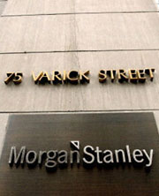



An institutional trade in a NYSE
Portfolio manager
POSIT
The world's largest equity crossing system, matches institutional buyers and sellers anonymously
Trader

Slide 28
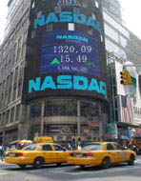
NASDAQ
National Association of Security Dealers Automated Quotations
OTC
Computer and telecommunications network
Market Maker Trading System

Slide 29
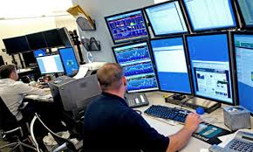
A retail trade in a NASDAQ
Client
Market Maker
Broker

Slide 30

An institutional trade in a NASDAQ
Market Maker
Portfolio manager
Trader

Slide 31
Session 3
Stock Trading Operation

Slide 32
Terminals

Slide 33
Stock Trading Operation Terminologies on Terminal
Order
Trade
Share
Share Price
Sell/Buy
Ask/Bid
Spread
T+1, T+0
Short Sell
Commission
Notes:
Order： 委托指令
Trade： 交易
Share：股份，股份代表对公司的部分拥有权，分为普通股、优先股、未完全兑付的股权
Share Price：每股价格
Sell/Buy： 卖/买
Ask/Bid：买入报价和卖出报价 Bid and Ask 两者合在一起称为“报价”
Spread：价差，某证券当前的买入与卖出价之间的价格差异
T+1, T+0：
Short Sell： 卖空
Commission: 佣金

Slide 34
Stock Trading Operation Terminologies on Terminal(cont.)
Last Price
Change
Currency
% Change
Open
Day Low
Day High
Volume
Notes:
Last Price： 收盘价
Change ： 股价变动
Currency:
% Change股价变动百分比
Open： 开盘价
Day Low
Day High
Volume：成交量

Slide 35
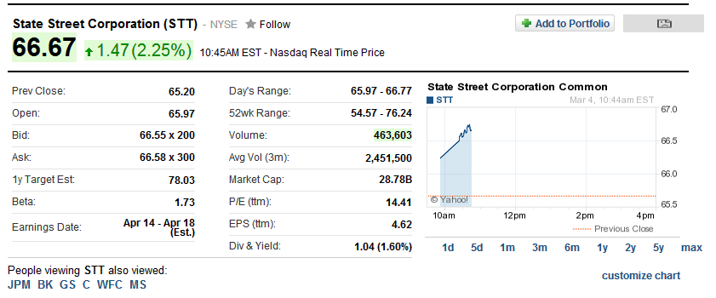
Stock Trading Operation Web-based Stock Information - Yahoo
Notes:
Beta系数：一般指某个股与大盘波动之间的敏感度

Slide 36
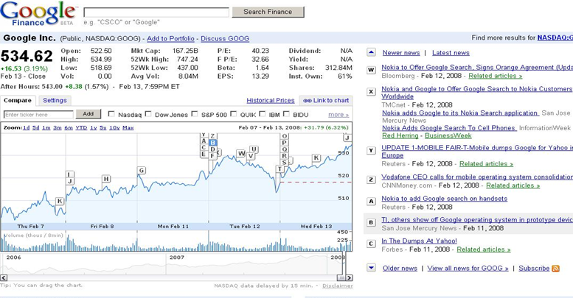
Stock Trading Operation Web-based Stock Information - Google

Slide 37
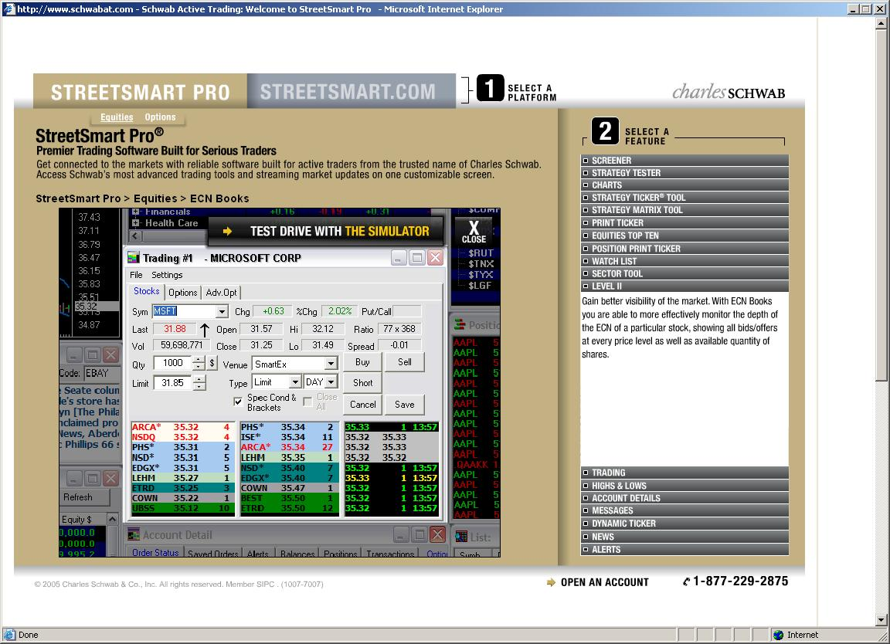
Stock Trading Operation Stock Trading Terminal - StreetSmart Pro

Slide 38
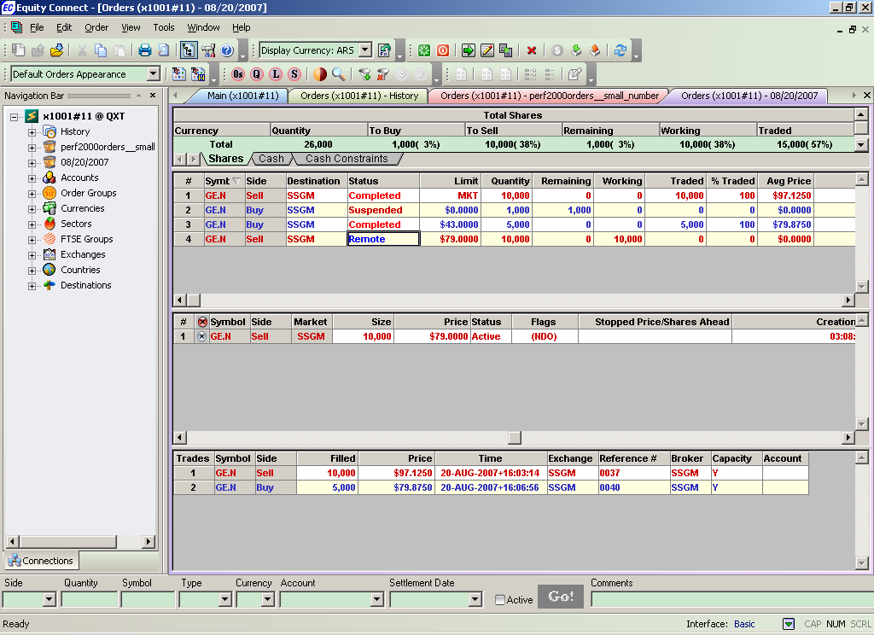
Stock Trading Operation State Street Equity Connect
New/suspend/Activate Order Icons
Order Lists (basket)
Summary View
Order Window-reflect order status
Security lists info
Quick Order Entry Bar

Slide 39
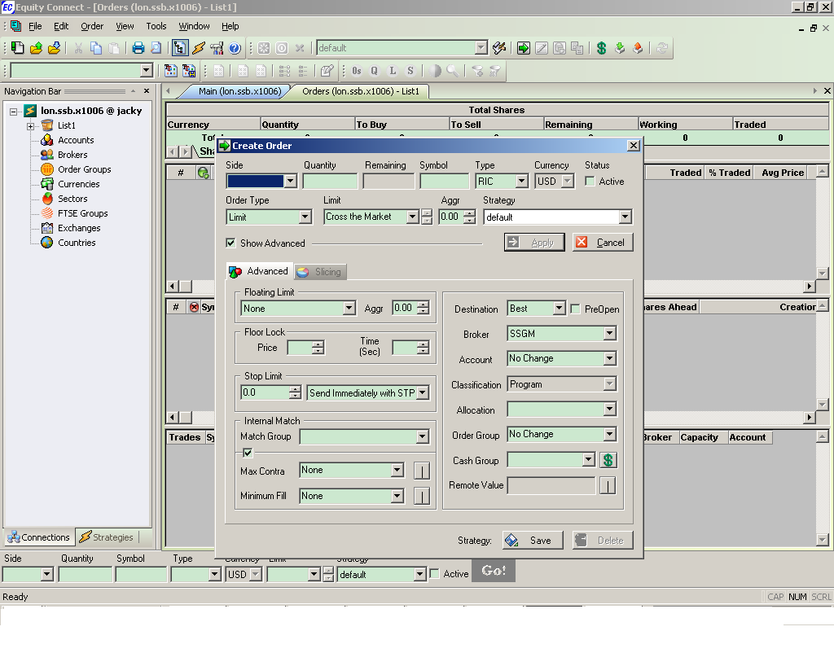
Stock Trading Operation Equity Connect – Order Creation
Input Basic Order Information
Advanced trading strategy setting area
Notes:
Securities
Receive/Deliver Against Payment
Receive/Deliver Free
Cash
Receive/Deliver Cash
Foreign Exchange
Account Transfer (not in current release)
Free Formats
Cash & Securities
Use one of the following to enter or select values:
select from drop-down list boxes pre-filled with your “favorites”
search by typing in the first few letters or numbers in the list box
find using content-specific searches
type the desired value
Select the correct dates using calendar pop-ups
Save selected and / or entered screen data at any time as a template, named by and available to the user or client
Transaction data includes:
Transaction status and type
User ID
Date/time last updated
UTID (unique transaction ID)
Your company’s own transaction reference number
Account number
Net amount
Settlement currency and date

Slide 40
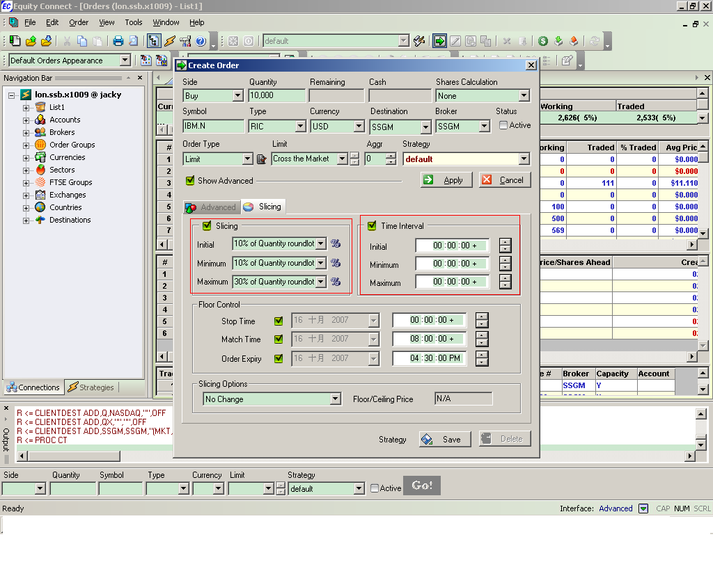
Stock Trading Operation Equity Connect - Slicing Option
Notes:
Slicing： round lot交易单位，一手

Slide 41
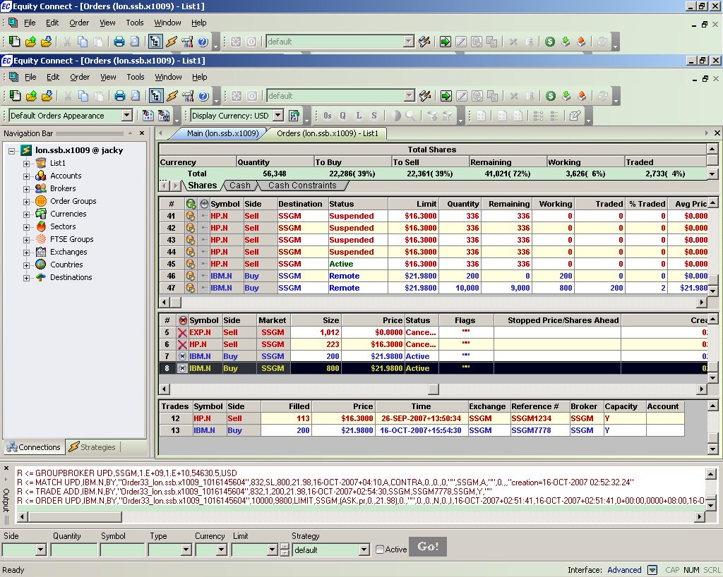
Stock Trading Operation Equity Connect – Slicing 2

Slide 42
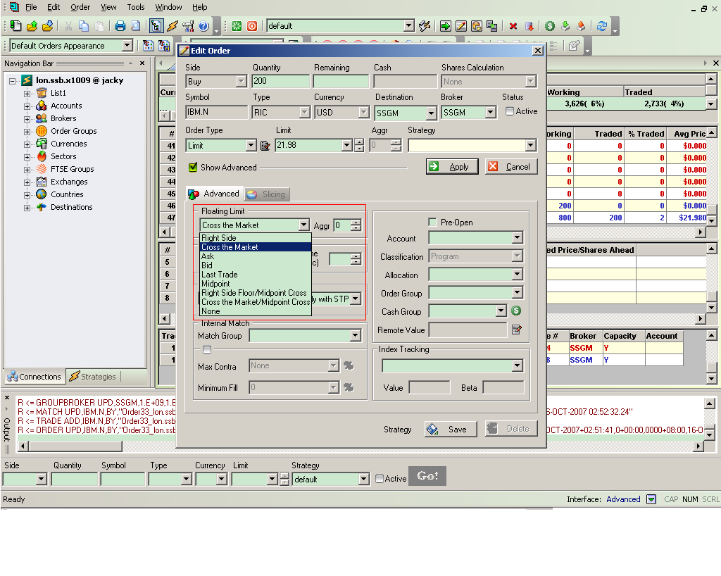
Stock Trading Operation Equity Connect – Floating Limit

Slide 43
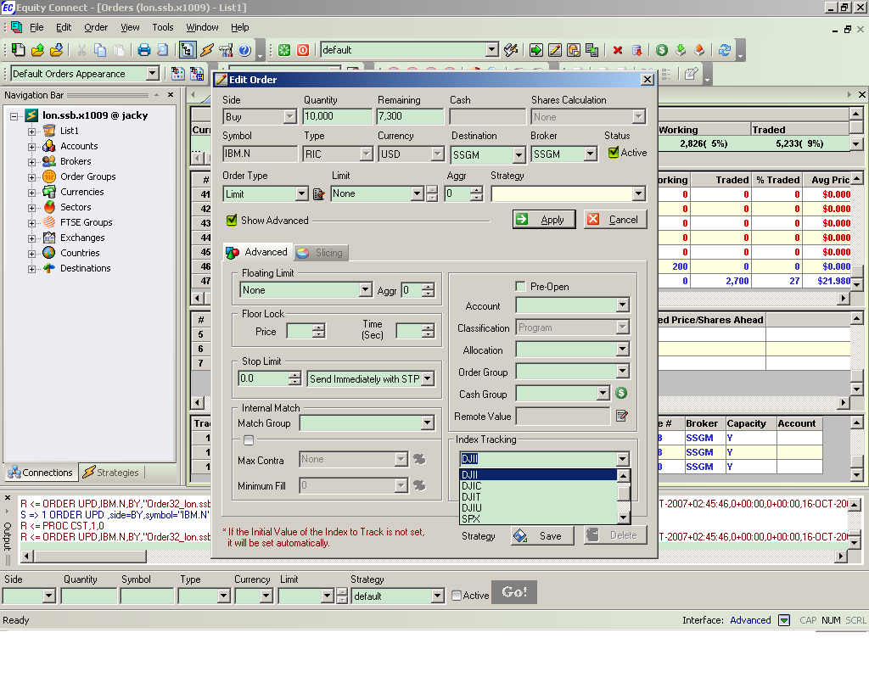
Stock Trading Operation Equity Connect – Index Tracking
Select the target index

Slide 44
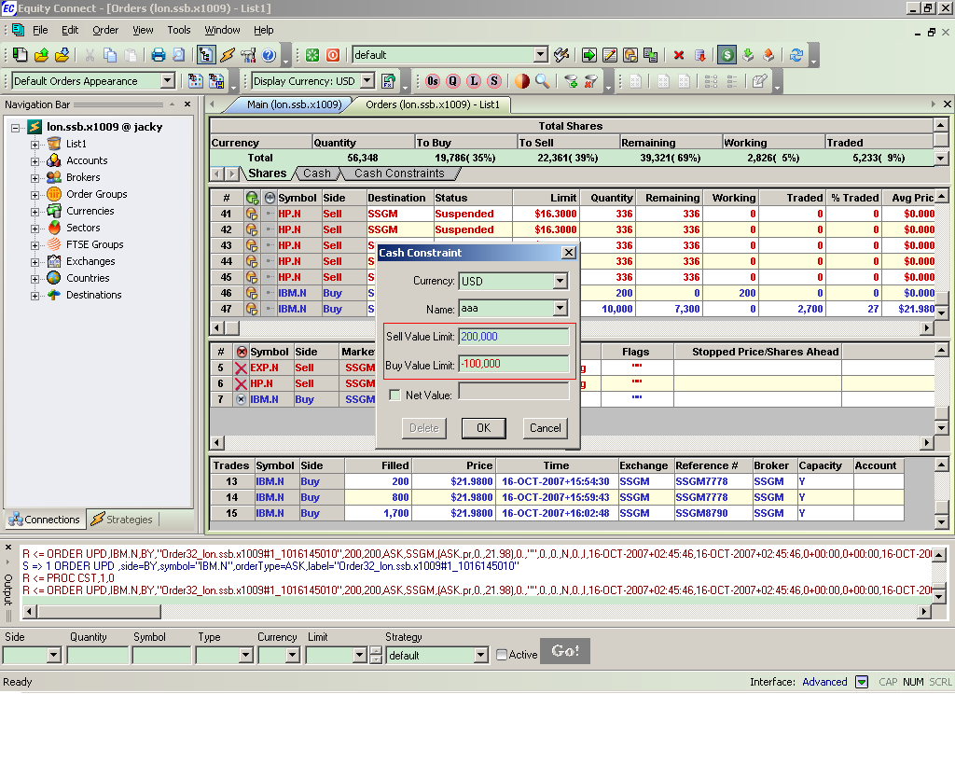
Stock Trading Operation Equity Connect – Cash Constraint

Slide 45
Stock Identifiers

Slide 46
Asset Identifiers (Security Code)
Numbering systems have been implemented which serve to identify specific classifications of a security.
With the complex structure of various markets, asset identifiers facilitate global trading, clearing and settlement activities.
There are various asset identifier numbering systems in use by various markets.

Slide 47
Asset Identifiers (cont.)
CUSIP (Committee on Uniform Security Identification Procedures)
  An identifier which is used for most US and Canadian securities.
  The nine alphanumeric code that reflects three different aspects of security. (Apple Inc.: 037833100)
CINS
  An acronym standing for the "CUSIP International Numbering System," which provides identification of international securities.
ISIN (International Securities Identifying Number)
  One universal security system worldwide.
  12-character alpha-numerical code (Apple Inc.: ISIN US0378331005)
SEDOL (Stands for Stock Exchange Daily Official List)
  Identify securities trading on the International Stock Exchange in London

Slide 48
Asset Identifiers (cont.)
Custody
Depository
International
Depository
Front Office
Mid/Back Office
ISIN
Trade code
ISIN
CUSIP
SEDOL
ISIN
CUSIP
SEDOL
ISIN

Slide 49
Orders

Slide 50
Order Types
Limit Risks
Speed of Execution
Price Improvement
Discretion
Market Timing

Slide 51
Order Types Limit Risks
Basket
  A group of individual orders that are saved in a single file and submitted as a package which diversify the risks.
Stop
  A Stop order becomes a market order to buy or sell securities or commodities once the specified stop price is attained or penetrated.
  A Sell Stop order is always placed below the current market price. It is typically used to limit a loss or protect a profit on a long stock position. A Buy Stop order is always placed above the current market price. It is typically used to limit a loss or protect a profit on a short sale.
Stop Limit
  A Stop Limit order becomes a limit order once the specified stop price is attained or penetrated.
  A STOP-LIMIT order eliminates the risk of a stop order where the investor is not guaranteed an execution price, but exposes the investor to the risk that the order may never be filled even though the stop price has been reached. The investor could "miss the market" in the security or commodity altogether.
Notes:
止损单(STOP ORDER)：这是一种当买方出价或卖方要价抵达预定价位时自动清仓的指令。
限价停损单 ( Stop-Limit Order ): 此种委托单结合了限价买单 ( Buy Limit Order ) 以及限价卖单 ( Sell Limit Order ) 二种形式。当股票达到一特定价格时，限价停损委托单便被使用。Limit order就包括限价买单 ( Buy Limit Order ) 以及限价卖单 ( Sell Limit Order ) 二种形式。

Slide 52
Order Types Speed of Execution
Market
  A market order is an order to buy or sell an asset at the bid or offer price currently available in the marketplace.
Market If Touched
  An MIT (market-if-touched) is an order to buy (or sell) an asset below (or above) the market. This order is held in the system until the trigger price is touched, and is then submitted as a market order. An MIT order is similar to a stop order, except that an MIT sell order is placed above the current market price, and a stop sell order is placed below.
Market On Open
  A market order executed at the market's open at the market price.
Market On Close
  A market order executed at the market's close at the market price.
Notes:
市价定单(Market Order)（又称市价委托）是按照当时可能是最好的价格立即（尽快）买进或卖出某一特定交割月份的一定数量外汇合同的定单，这种定单并不规定具体的成交价格只规定交割月份的合同数量
触及市价单 (MIT, Market if touched) 是一种设定成交前提的交易指令：一旦市价触及所设的价格,该指令自动变成市价单,即须按当时所能取得的最佳价格尽快成交. 经纪人接获这种交易指令,只要当天市价曾触及所设价格,即必须以市价完成交易,不得推诿因故无法成交.

Slide 53
Order Types Speed of Execution (cont.)
Pegged to Market
  An order that is pegged to buy on the best offer and sell on the best bid.
VWAP
  The VWAP for a stock is calculated by adding the dollars traded for every transaction in that stock ("price" x "number of shares traded") and dividing the total shares traded. A VWAP is computed from the open of the market to the market close, and is calculated by volume weighting all transactions during this time period.
Notes:
Pegged to Market: 盯住市场or挂钩市场被限定以最佳要价买入和以最佳出价卖出的定单。
VWAP - Best Efforts（交易量加权平均价格－最大努力） （交易量加权平均价格－最大努力） 该 IB 算法基于最大努力，在不超过用户定义的日交易量最大百分比的情况下，获得交易量 加权平均价格。
VWAP - Guaranteed（交易量加权平均价格定单） （交易量加权平均价格定单） 为帮助客户减少交易风险，IB 对大市值股票支持交易量加权平均价格。股票的 VWAP 按如 下方法计算：把该股票每笔交易的交易金额加起来（“价格”×“交易的股票数量”）并除以交 易的总股数。 交易量加权平均价格从开始的截止时点一直计算到结束的截止时点， 并根据对该时段内的所 以交易加权来计算。VWAP 价格由 Bloomberg 计算，在市场收盘后显示，并被保证执行。 默认情况下， 开始截止时点为从市场开盘到市场收盘的每分钟。 交易平台将自动地对下一分 钟截止时点提交的 VWAP 定单， 除非通过点击有效时间区域并使用时钟功能选择新时间来选 择了一个不同的开始截止时点。 能够通过使用到期时间区域的时钟功能来修改计算的结束截 止时点（默认为市场收盘时） 。

Slide 54
Order Types Price Improvement
Limit
  A limit order is an order to buy or sell a contract at a specified price or better.
Limit If Touched
  An LIT (limit-if-touched) is an order to buy (or sell) an asset below (or above) the market, at the defined limit price or better. This order is held in the system until the trigger price is touched, and is then submitted as a limit order. An LIT order is similar to a stop limit order, except that an LIT sell order is placed above the current market price, and a stop limit sell order is placed below.
Notes:
Limit-if-Touched（触及限价） 定单以指定限价或更好价格买入（或卖出）低于（或高于）市场价格的资产。 这种定单一直被持有在系统中，直到触发价格被触及，然后作为限价定单被提交。

Slide 55
Order Types Discretion
Discretionary
  A Discretionary Order is a limit order for which you define a discretionary amount (which is added to or subtracted from the limit price) that increases the price range over which the order is eligible to execute. The original limit price is displayed to the market.
Hidden
  A Hidden order (generally a large volume order) shows no evidence of its existence in either the market data or the deep book
Iceberg
  An Iceberg order allows you to submit an order (generally a large volume order) while publicly disclosing only a portion of the submitted order.
Notes:
Discretion酌处权
Discretionary全权委托定单是一种限价定单， 您对其定义一个任意的金额 （将被添加到限价中或从限价中扣减） ，该金额会增大定单能够执行的价格范围。最初的限价被显示给市场。
Hidden 隐藏定单（通常是大交易量定单），既不在市场数据中也不在深层交易册中显示其存在。
Iceberg Order 冰山指令是把一笔大单分成很多个小单， 下达这些小单通常是使用程序化交易来实现， 这样 做的目的是为了隐藏其实际大单的数量。 例如：当参与者，如大型机构投资者，需要购买和出售证券投资组合的量非常大，他们可以 划分成很多小单，让公众看到每次只能发现一小部分的指令。好像是‘冰山一角’只是一个巨大的冰块质量的可见部分。 通过隐藏其大的规模， 冰山指令降低了由大幅度买卖股票带来的 价格波动。

Slide 56
Order Types Market Timing
All or None
  An AON (all or none) order will remain at the exchange (or in the IB system) until the entire quantity is available to be executed.
Fill or Kill
  A FOK (Fill or Kill) order must execute as a complete order as soon as it becomes available on the market, otherwise the order is canceled.
GTD
  A GTD (Good-till-Date) order valid until the date specified.
GTC
  A GTC (Good-till-Canceled) order is an order to buy or sell a security at a specific or limit price that lasts until the order is completed or cancelled. A GTC order will not be filled until the limit has been reached, no matter how many days or weeks it takes.
IOC
  An IOC (Immediate or Canceled) order requires that all or part of the order be executed as soon as it is brought to the market, whereby the portion not executed is automatically canceled.
Notes:
All-or-None（全或无指令） 使用全或无（AON）属性的定单，只有当整个数量在特定的价格或更好价格可用时才将被执 行。定单将保持活动直到：整个数量在特定的价格（或更好）可用。或者定单被取消。
Fill-or-Kill 全数执行或立刻取消指令，将有效时间设置为全数执行或立刻取消（FOK） ，规定整个定单必须立刻执行或者被取消。
Good-till-Date/Time（到期/到时前有效指令） GTD（到期/到时前有效）有效时间让指定一个到期日期和时间，直到这之前定单都将继续 工作。设定该属性需要选定到期前有效（GTD）作为有效时间，在到期日期区域中输入一个 日期，并在到期时间区域中输入一个时间（如果需要该水平的细节） 。注意，如果只输入了 到期前有效的日期，未执行的定单将在指定日的市场收盘时取消。
Good-till-Canceled（取消前有效指令 一种使用取消前有效（GTC）作为有效时间的定单，将继续工作直到定单执行或被取消。
Immediate-or-Cancel 立刻执行或取消指令应用于定单的立刻执行或取消（IOC）有效时间命令定单任何未立刻执行的部分将被取消。

Slide 57
Session 4
Analyzing Stocks

Slide 58
Price Changing
Stock prices change according to supply and demand. There are many factors influencing prices, the most important being earnings.
Earnings are the profit a company makes, and in the long run no company can survive without them.
Nobody really knows for sure why stock prices change.

Slide 59
Stock Investment Features
Long term
Clear investing goal and self-acceptance of risk
Emphasize the risk control and have accurate risk budget
Take eyes on the whole portfolio management
Large orders to affect the whole market
…

Slide 60
Two Analysis Models
Fundamental Analysis (Buying a Business)
  fundamental analysis is a technique that attempts to determine a security’s value by focusing on underlying factors that affect a company's actual business and its future prospects.
  It maintains that markets may mis-price a security in the short run but that the "correct" price will eventually be reached. Profits can be made by trading the mispriced security and then waiting for the market to recognize its "mistake" and reprice the security.
Technical analysis (Buying the Numbers)
  It maintains that all information is reflected already in the stock price,
  Investors' emotional responses to price movements lead to recognizable price chart patterns.
  Their price predictions are only extrapolations from historical price patterns.

Slide 61
Fundamental Analysis

Slide 62
Approach
Top-down
  Investor starts his analysis with global economics, and then narrows his search down to regional/industry analysis. Finally he narrow his search to the best business in that area.
Bottom-up
  Investor starts his analysis with a specific business.

Slide 63
Factors
Company’s History and Current Status
  Earning
  Sales
  Management
  Governance
  Balance Sheet/Income Statement/Cash-flow Statement
  Strength of Products in Marketplace
  …
Industry Status
  Market Shares
  Industry Growth
  Competition
  Regulation
  …

Slide 64
Measurements
Price/Book Ratio
Price/Free Cash Flow Ratio
Price/Earning Ratio (P/E)
Price/Sales Ratio
Revenue/Share
Operation Income/Share
EPS (Earnings Per Share)
Equity/Share
…
Notes:
EPS(每股盈余)=盈余/流通在外股数，传统的每股收益指标计算公式为：每股收益=期末净利润÷期末总股本。EPS为公司获利能力的最后结果。
市盈率是最常用来评估股价水平是否合理的指标之一，由股价除以年度每股盈余(EPS）得出

Slide 65
Equity Pricing Models
P/E Ratio Pricing Model
Dividend Discount Model (DDM)
Capital Asset Pricing Model (CAPM)
Arbitrage pricing theory (APT)
Notes:
P/E Ratio Pricing Model: 市盈率定价模型 发行价格=每股收益×发行市盈率
威廉姆斯（Williams）1938年提出了公司（股票）价值评估的股利贴现模型（DDM）,为定量分析虚拟资本、资产和公司价值奠定了理论基础，也为证券投资的基本分析提供了强有力的理论根据。

Slide 66
Technical Analysis

Slide 67
Principle
Price Discounts Everything
Prices move in trends
History repeats itself
** Not Just for Stock

Slide 68
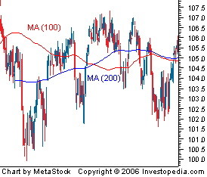
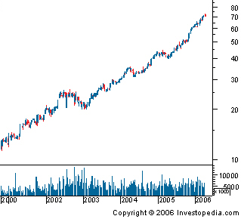
Trend Definition
A trend the general direction in which a security or market is headed
Trends are not always easy to see
The trend is your friend

Slide 69
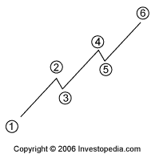
Trend Types
UpTrend
DownTrend
Sideways/Horizontal Trends
Notes:
横盘/横向趋势

Slide 70
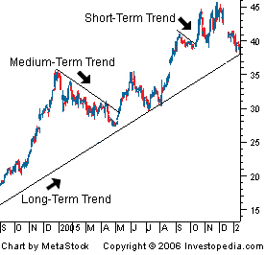
Trend Terms
The longer the trend, the more important
Weekly charts or daily charts spanning a five-year period are used to identify long-tern trends
Daily data charts are best used when analyzing both intermediate and short-term trends.

Slide 71
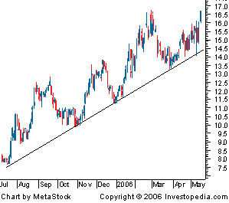
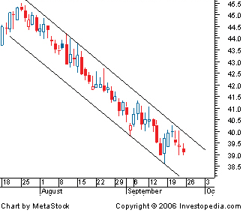
Trend Lines and Trend Channels
Trend Line
Trend Channel

Slide 72
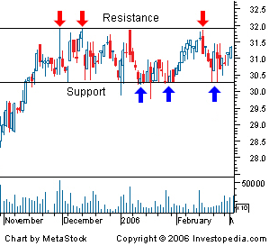
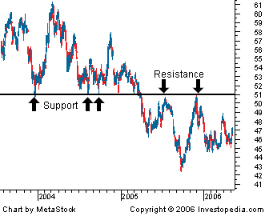
Trend--Support/Resistance
Reversal

Slide 73
Volume is important
Volume is simply the number of shares or contracts that trade over a given period of time.
The higher the volume, the more active the security.
Volume should move with the trend.
Volume confirm Chart Patterns
Volume Precedes Price

Slide 74
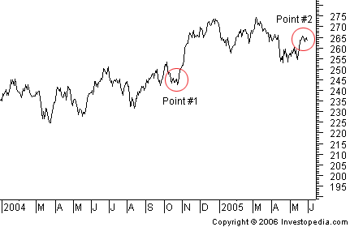
Chart Definition
Charts are similar to the charts that you see in any business setting. A chart is simply a graphical representation of a series of prices over a set time frame

Slide 75
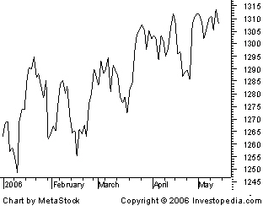
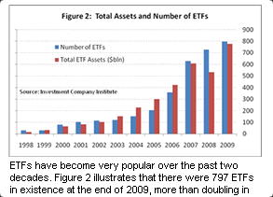
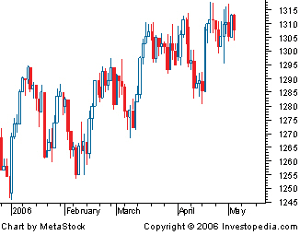
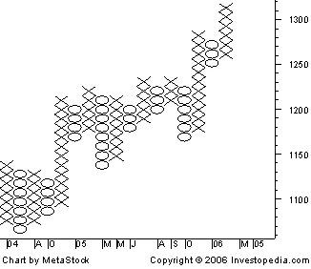
Chart Types
Line Chart
Bar Chart
Candle Chart
Point and Figure Chart

Slide 76
Chart Pattern
Reversal Chart Patterns: Head and Shoulders and Inverted Head and Shoulders
Reversal Chart Patterns: Triple and Double Tops and Bottoms
Reversal Chart Patterns: V-Reversal Pattern
Continuation Chart Patterns: Triangles
Notes:
Reversal Chart Patterns 反转形态
头肩形
三重顶，底
二重顶，底
V型

Slide 77
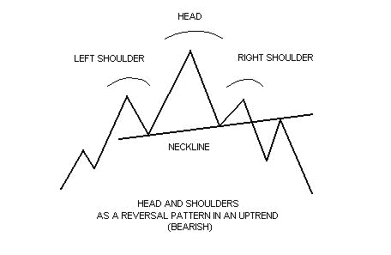
Chart Pattern– Head and Shoulders
Head and shoulder (can be inverted too)

Slide 78
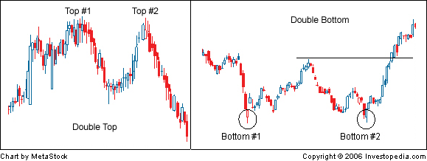
Chart Pattern– Double Tops and Bottoms

Slide 79
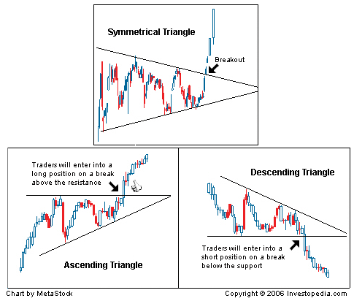
Chart Pattern– Triangles

Slide 80
Moving Average
Most chart patterns show a lot of variation in price movement which makes it difficult get an idea of a security's overall trend.
A moving average is the average price of a security over a set amount of time. By plotting a security's average price, the price movement is smoothed out.
Simple Moving Average takes the sum of all of the past closing prices over the time period and divides the result by the number of prices used in the calculation.
More complicated Moving Averages can be calculated by adding more factors

Slide 81
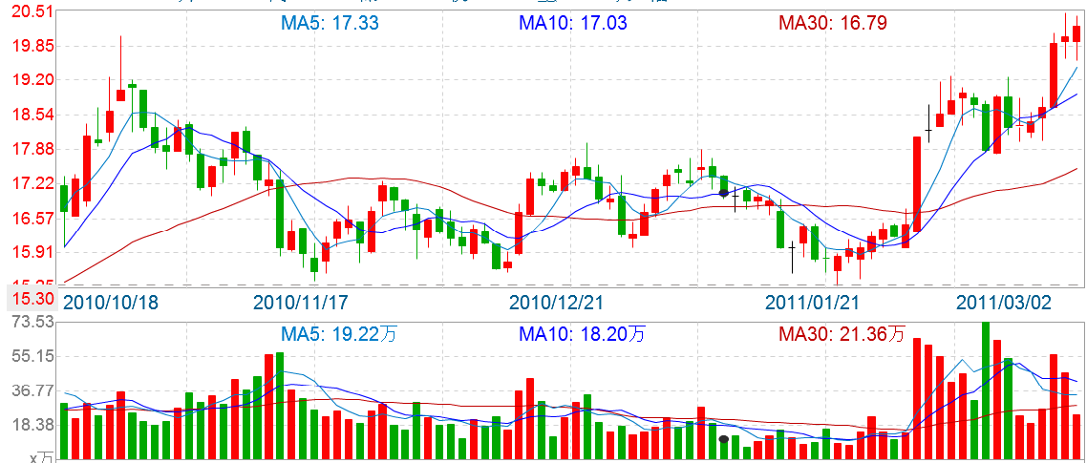
Moving Average Sample

Slide 82
Indicator Definition
Indicators are calculations based on the price and the volume of a security
There are two main types of indicators: leading and lagging.
  A leading indicator precedes price movements, which gives a predictive quality
  A lagging indicator is a confirmation tool, which follows price movement.
Indicators confirm each other
…

Slide 83
Indicators
Bollinger Bands
Candle Stick Trend
Breakout
Momentum
Money Flow
Relative Strength Index (RSI)
…

Slide 84
Indicator Sample – RSI
Formula:
RSI = 100 - 100 / (1 + U / D)
Where:
U - average value of the positive price changes (Up close) over a period;
D - average value of the negative price changes (Down close) over a period;
The most frequently used time periods are 8 and 14.
RSI indicator is considered overbought if it is above the 70 level, and oversold if it is below the 30 level. RSI signals:
  If the indicator is below the 50 line, then the market is considered to be bearish;
  If above the 50 level, then the market is considered to be bullish;
  If the indicator is around the 50 line it signals that the market is flat;
  Bullish divergence / bearish convergence – the main signal of the trend weakness;
  Under flat conditions exit from the overbought (oversold) territory is a signal to sell (buy);
  Different types of the trend analysis can be used to analyze RSI: trend lines, support / resistance levels, chart reversal and continuation patterns.

Slide 85
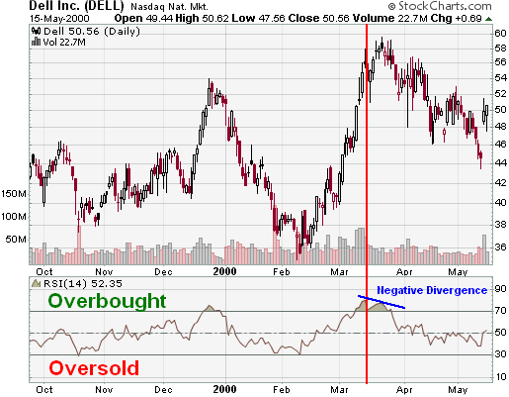
Indicator Sample – RSI (cont.)
Overbought/Oversold
Divergences
Centerline Crossover
The DELL example shows a number of extreme readings as well as a negative divergence. In Oct-99, RSI reached oversold for a brief moment to mark the low around 38. The next extreme reading (overbought) occurred after a large advance that peaked in Dec-99. RSI reached overbought levels in late Dec-99 and moved below 50 by the second week of Jan-00. The next oversold reading occurred in Feb. for another brief moment and marked the low around 35. By the end of Feb-00, RSI moved back above 50 and into overbought territory in March. A negative divergence formed in March and marked the high in the upper fifties.

